Slide 1
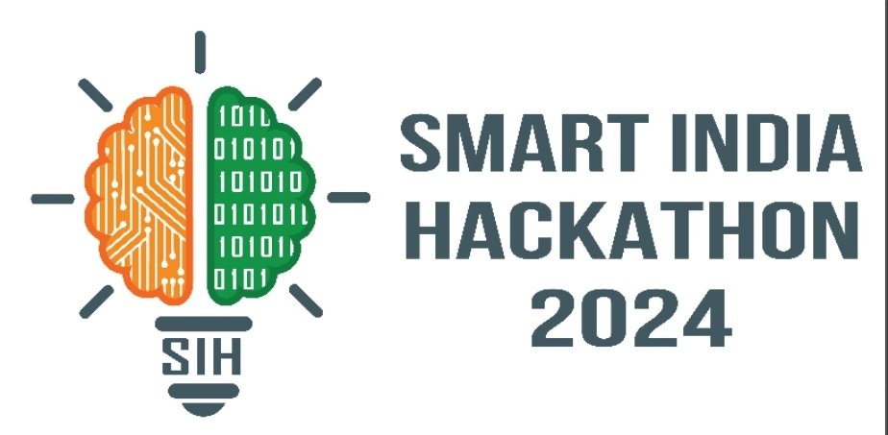
Basic Details of the Team and Problem Statement
Problem Statement ID:
Problem Statement Tittle:
Theme:
PS Category:
Team ID:
Team Name:

Slide 2
Idea/Approach Details
Uniqueness:
Precision Irrigation: Water supply depending on real-time soil moisture data.
Solar-Powered for Energy Efficiency: By utilizing solar energy, the system is energy efficient thus making it very sustainable.
Customizable Design:Users can customize it by setting thresholds of moistures and watering schedules for various plant types.
Smart Integration with IoT and AI: For monitoring from a distance through IoT as well as learning how to deal with varying needs of diverse plants when watering is concerned via AI.
Proposed Solution:
1. Install Soil Moisture Sensors in key zones to monitor real-time soil moisture levels.
2. Implement Smart Controllers with cloud connectivity for remote control and automatic scheduling.
3. Install solar panels to harness renewable energy, powering the entire irrigation system.
4. Integrate Automated Sprinklers systems to deliver precise water amounts.
5. Utilize Data Analytics to optimize water usage and detect inefficiencies.
6. Connect via Wireless Networks for seamless communication between components.

Slide 4
Idea/Approach Details
Procedure to implement:
Technology Used:
Component Identification: Suitable sensors, microcontroller, communication module, and power source are selected.
Control Unit Placement: Find a central location (e.g., Arduino, Raspberry Pi) to place the control unit so it can easily connect the moisture sensors to the sprinklers.
Software Design: Develop or plan the software architecture to process data and control system.
Network Configuration: Set communication requirements for remote monitoring and control, and to connect the system to mobile interface.
User Interface and App/Web Interface:The user interfaces like web/app is developed and connected for controlling,viewing sensor data.
Sensors: Soil Moisture
Smart Controllers: Arduino
Communication Networks: Wireless (Wi-Fi, Zigbee, LoRa), Bluetooth
Automated Systems: Sprinklers
Data Analytics: Real-time Monitoring
User Interface: Mobile applications and websites

Slide 5
Challenges and risks with solutions
Challenges
Solutions
Keeping a steady power supply can be tough in far-off
Reading data from moisture sensors can be tough when there are inconsistencies or when other factors like uneven soil moisture affect the data.
Wireless communication between sensors, control units and user interfaces can break down
Weather changes, temperature swings, and soil issues can mess with how sensors and other parts work.
Solar Power with Battery Backup can be used.
Set up a mesh network. This allows data to jump between devices and extends the range and makes the system more reliable.
Pick sensors and parts made for outdoor use that can handle rough conditions
Put multiple sensors to use and combine their data to obtain a clearer overall picture of soil moisture levels.

Slide 6
Benefits of the solution:
Smart Water Use
Saving Water
Sourses
Energy Efficiency
Optimal Watering
Reduced Plant Stress
Less Water Runoff
Stopping erosion
Remote Monitoring and Control
Automated Decision-Making

